Slide 1
GESTURE RECOGNIZATION VIA TINYML
Submitted by: Amulya Yadagani
Mentored by: Dr.Somya Mohanty
30/11/2020

Slide 2
OUTLINE
Introduction
Goals
Challenges
Methodology Workflow
Data Collection
Deep Learning Workflow
Data Preprocessing
Train, Test, Validation Sets
Building Deep Learning Model
Compiling & Fitting the model
Model Pruning & Quantization
Model Inference
Results
Conclusion
Reference

Slide 3
Introduction
Machine Learning on Microcontrollers is the most efficient, cheap, and reliable way of developing Edge Computing applications with low energy consumption.
‘Arduino Nano 33 BLE Sense board’ is used as a microcontroller to capture and classify 5 human gestures - “Squat”, “Jump”, “Walk”, “Run”, “Other”.
The board has capabilities such as embedded sensors and BLE enabled.
Built Deep Learning model using captured gestures data to classify human gestures

Slide 4
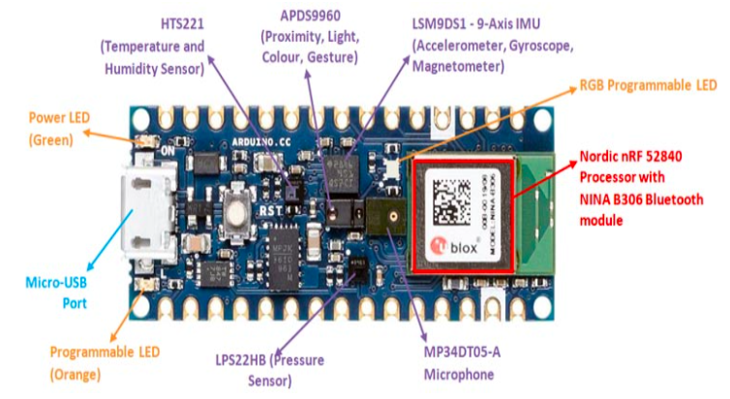
Microcontroller - Arduino Nano 33 BLE Sense

Slide 5
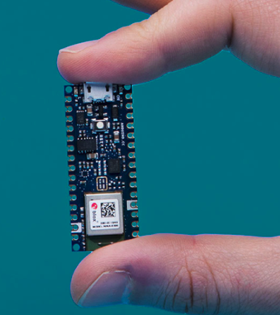
Tiny form factor having 45x18mm dimensions
9 on-board sensors, in this research accelerometer and gyroscope inertial sensors are used.
Nordic nRF52840 processor
32-bit ARM Cortex M4 CPU
NINA B306 module for BLE
SRAM : 256KB
Flash Memory : 1MB
Operating Voltage : 3.3V

Slide 6
Goals
To showcase the following benefits in developing Edge Computing applications without sacrificing accuracy on Microcontrollers such as Arduino Nano 33 BLE Sense board:
Cost Effective
Low Energy Consumption
Data Privacy
Tiny form factor
Flexibility

Slide 7
Challenges & Workaround
Challenge 1: Capturing Training Data from the Arduino Board
Workaround: Python script to capture data via BLE
Challenge 2: The size of the traditional Machine Learning model is huge, loading the model onto the microcontroller
Workaround: Pruning and Quantization techniques to reduce model size
Notes:
Publically available dataset deidentify

Slide 8
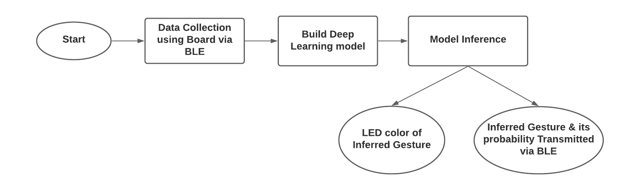
Methodology Workflow

Slide 9
Data Collection
The board is programmed to capture the 3-axis accelerometer and a 3-axis gyroscope data using the inertial sensors (IMU)
Accelerometer range is set at [-4,+4]g -/+0.122 mg
Gyroscope range is set at [-2000, +2000] dps +/-70 mdps
Magnetometer range is set at [-400, +400] uT +/-0.014 uT
IMU Sampling Rates : [10Hz, 50 hz, 119 hz, 238 hz, 476 hz, 952 hz]
Each gesture is performed 100 times with a sampling rate of 119 Hz and a minimum Threshold of 1.5

Slide 10
Data transferred via BLE from board (central) to the system (peripheral)
Python script to discover BLE device and establish connection using devices GATT services and its characteristics
For a gesture, data is sent continuously until all samples (119) are read.
The data is sent in the form of a string

Slide 11
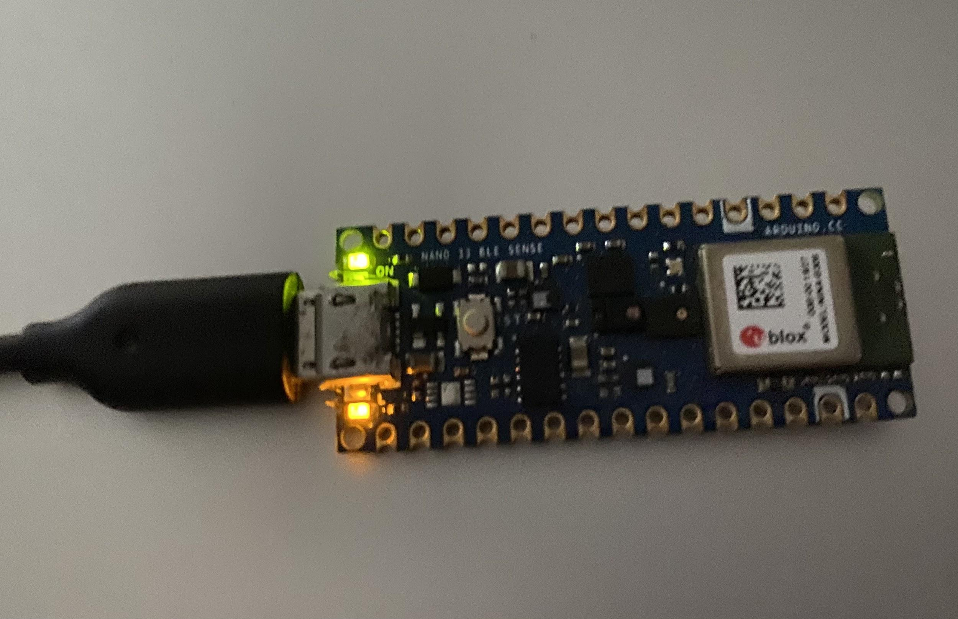
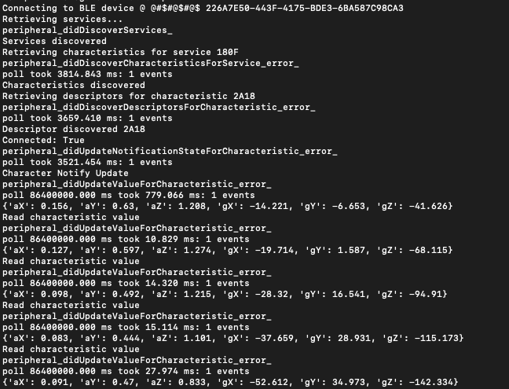
BLE connected

Slide 12
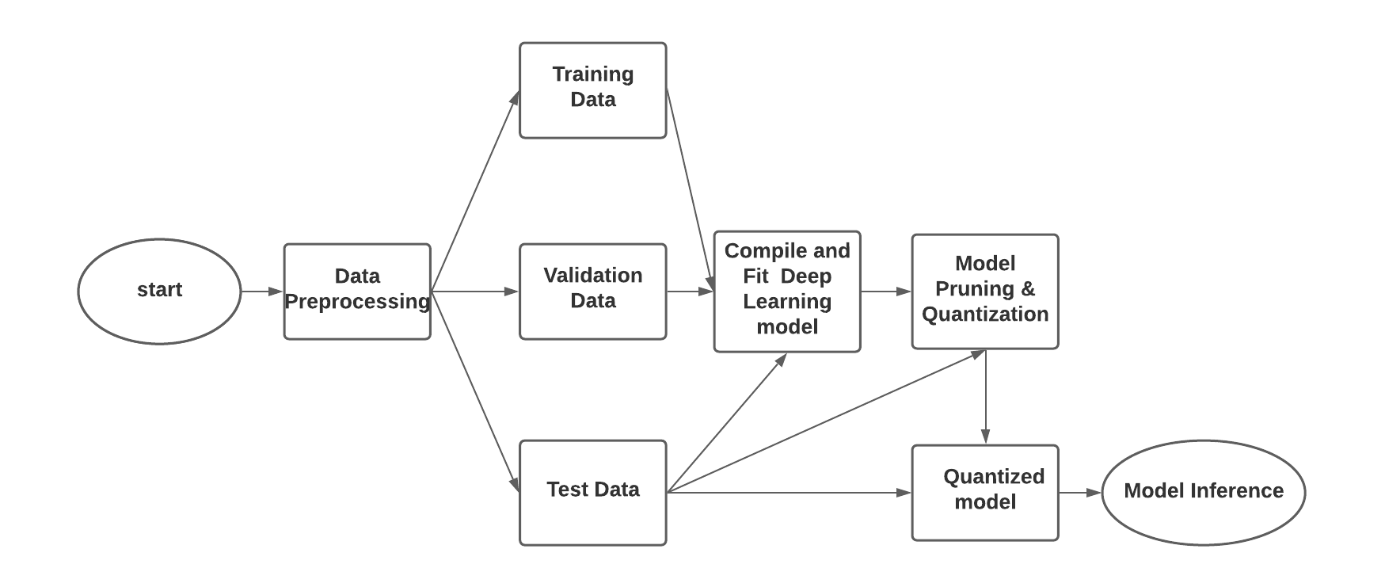
Deep Learning WorkFlow

Slide 13
Data Preprocessing
Deep learning models accept input and generate output in the form of tensors
Transformed the input into tensor with shape (500, 716)
500 : 100 samples for each of 5 gestures
716 : each sample rate X (accelerometer,gyroscope) = 119 x 6 = 716
Transformed the output into tensor with shape (500, 5)
500 : 100 samples for each of 5 gestures
5 : one-hot encoded matrix for each of 5 gestures

Slide 14
Train, Test and Validation Sets
Shuffle input and output data
Shuffled data is split into
60% training
20% test
20% validation

Slide 15
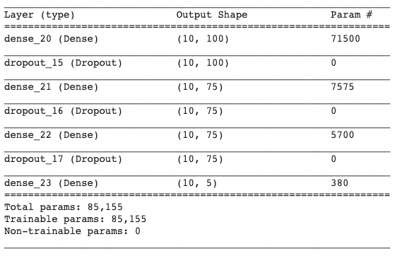
Building Deep Learning Model
Consists of total 7 layers
4 are "Dense" layers (nodes per layer: 100, 75, 75, 5)
3 are "Dropout" (0.15)
Rectified linear activation function (ReLU) outputs the input directly if it is positive or it will output zero

Slide 16
Compiling and Fitting the model
Compiling the model takes 3 parameters - optimizer, loss, metrics
“Adam” optimizer with learning rate=0.0001
“mean_squared_error” as a loss function
“accuracy” of model as metrics
“ ReduceLROnPlateau” is used as a callback to reduce the learning rate when a metric has stopped improving

Slide 17
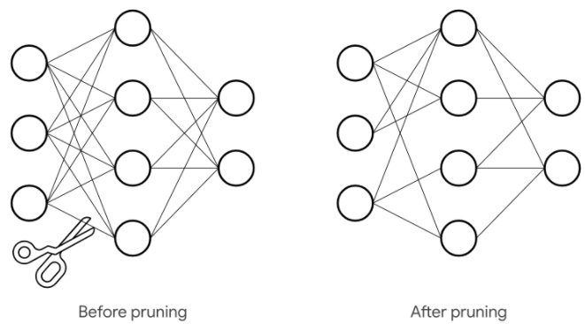
Model Pruning and Quantization
why?
Reduces model size
Faster Execution
Reduces Power consumption
Pruning is an iterative process on a trained model that trims insignificant weights by setting those weights to zero until specified target sparsity
Removes unnecessary connections between the layers

Slide 18
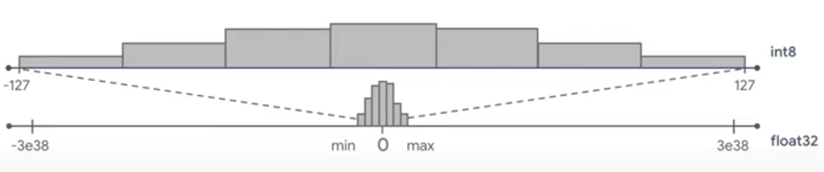
Quantization is a process where the weights are converted to lower-precision types, such as from float32 to int8.
How it works?
Take only the required range used by Float32 to represent in smaller no of bits
Required Range : Histogram distribution of values in a particular tensor by grouping data into 255 bins which is integer equivalent.
quantized_value = float_value / scale + zero_point
scale = (max - min)/ 2^bits (Floating point size of each bin)
zero_point = integer zero that corresponds floating point zero

Slide 19
Model Inference
Board is programmed to use the trained TensorFlow Lite model for the classification of gestures
Board is programmed with
static tensor size (40x1024),
string characteristic UUID to transfer the output
an interpreter to run the deep learning model
Highest probability gesture indicated by LED light and transmitted via Bluetooth.

Slide 20
Gestures LED color
Gesture | LED Color
Squat | Red
Jump | Magenta
Walk | Blue
Run | Green
Other | White

Slide 21
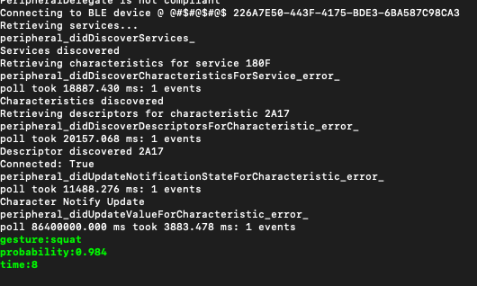
Gestures Output

Slide 22
RESULTS

Slide 23
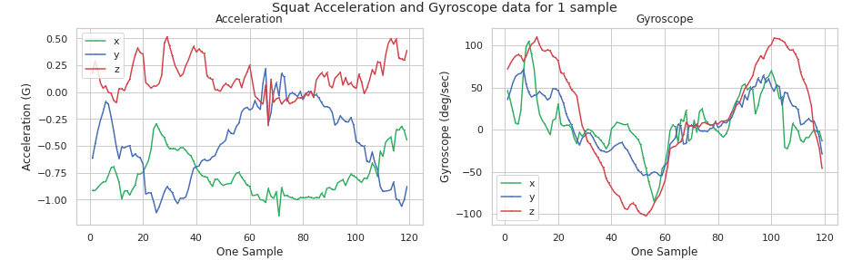
Data Collection Results
Visualization of Squat Data - One Sample

Slide 24
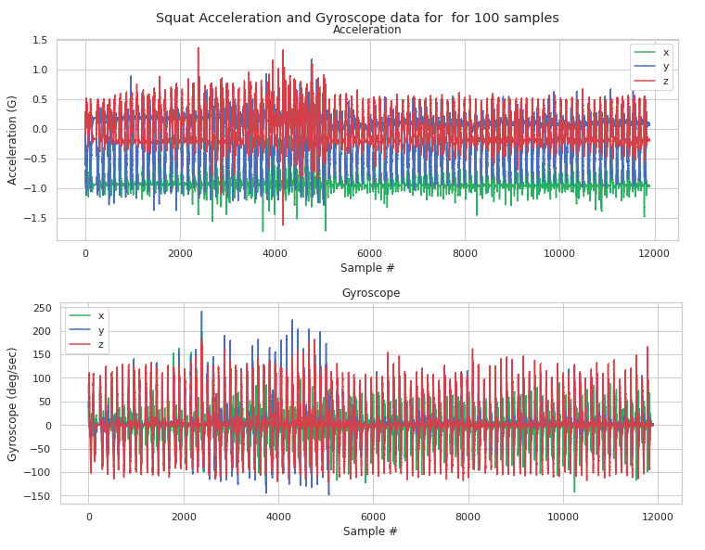
Visualization of Squat Data - 100 Samples

Slide 25
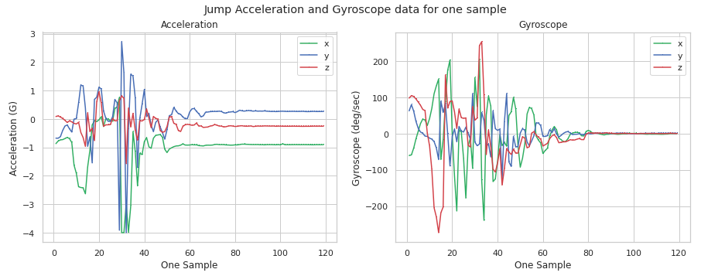
Visualization of Jump Data - One Sample

Slide 26
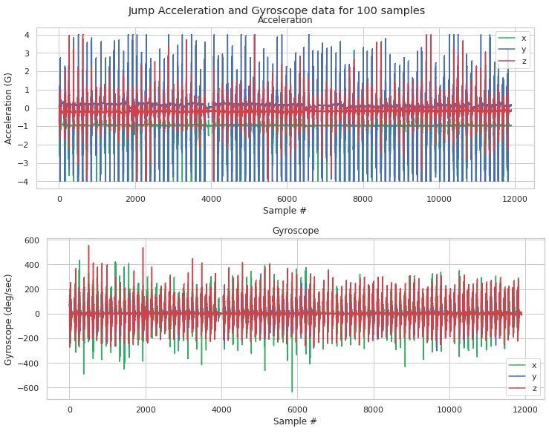
Visualization of Jump Data - 100 Samples

Slide 27
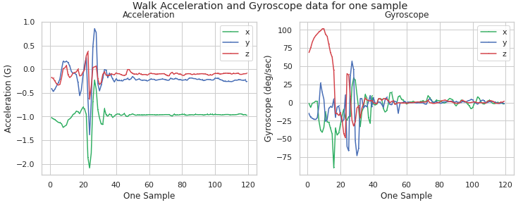
Visualization of Walk Data - One Sample

Slide 28
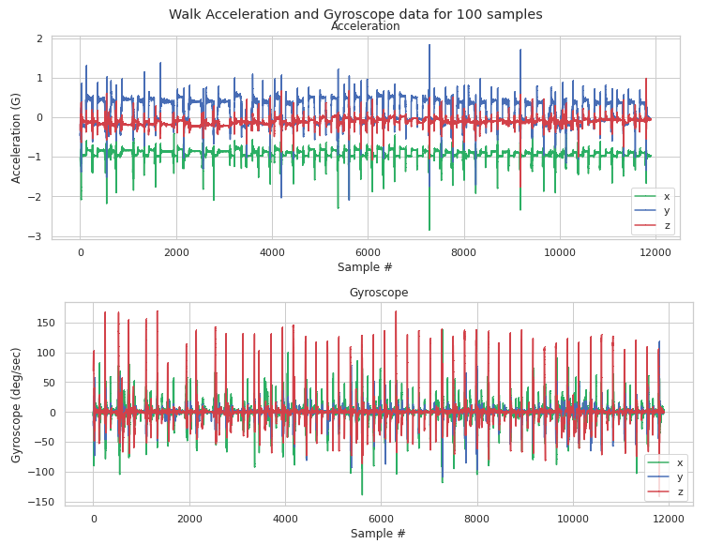
Visualization of Walk Data - 100 Samples

Slide 29
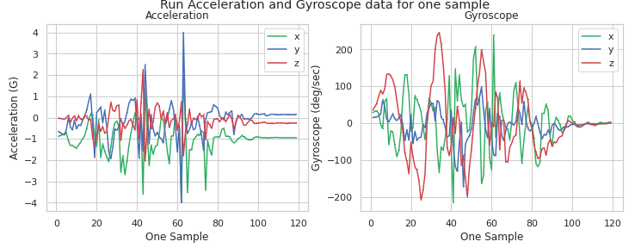
Visualization of Run Data - One Sample

Slide 30
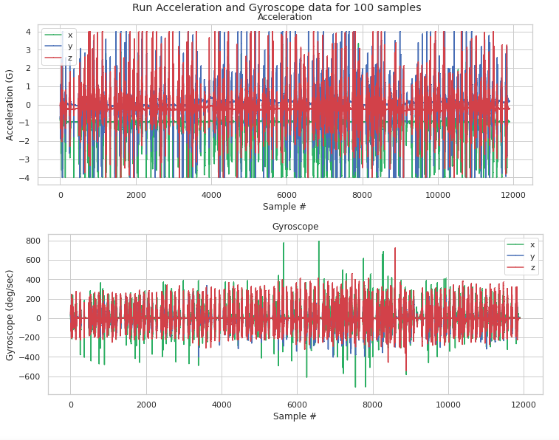
Visualization of Run Data - 100 Samples

Slide 31
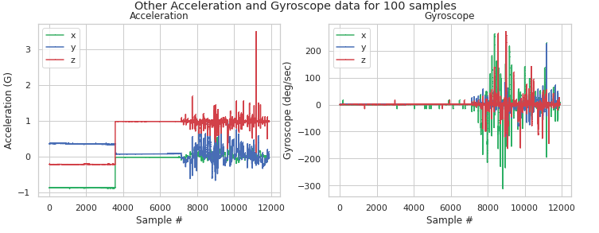
Visualization of Other Data - 100 Samples

Slide 32
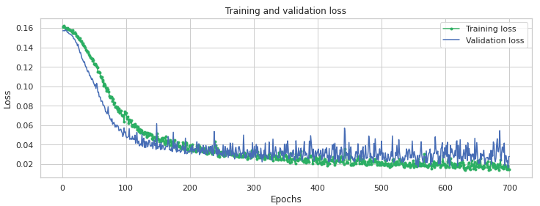
Training and validation loss of the trained model
Deep Learning Results

Slide 33
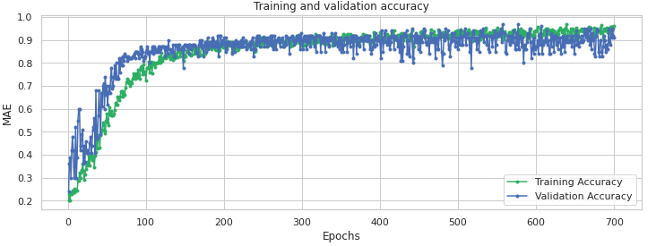
Training and validation Accuracy of the trained model

Slide 34
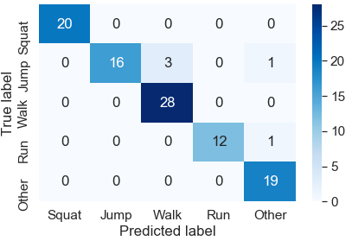
Confusion Matrix of the trained model

Slide 35
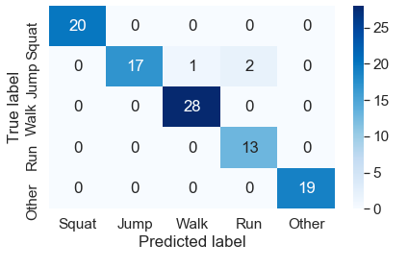
Size, Accuracy and Confusion Matrix of the compression model
Size of the model is reduced 4 times from 2.1Mb to 0.5Mb
96% accuracy

Slide 36
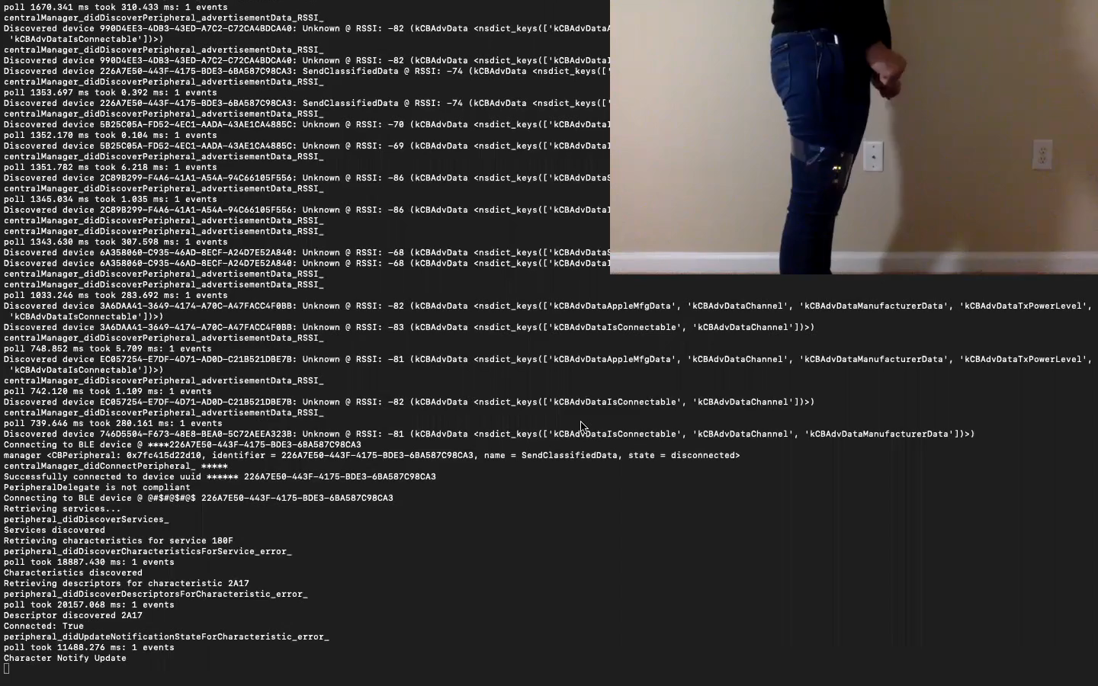
Predicting Squat gesture
Demo

Slide 37
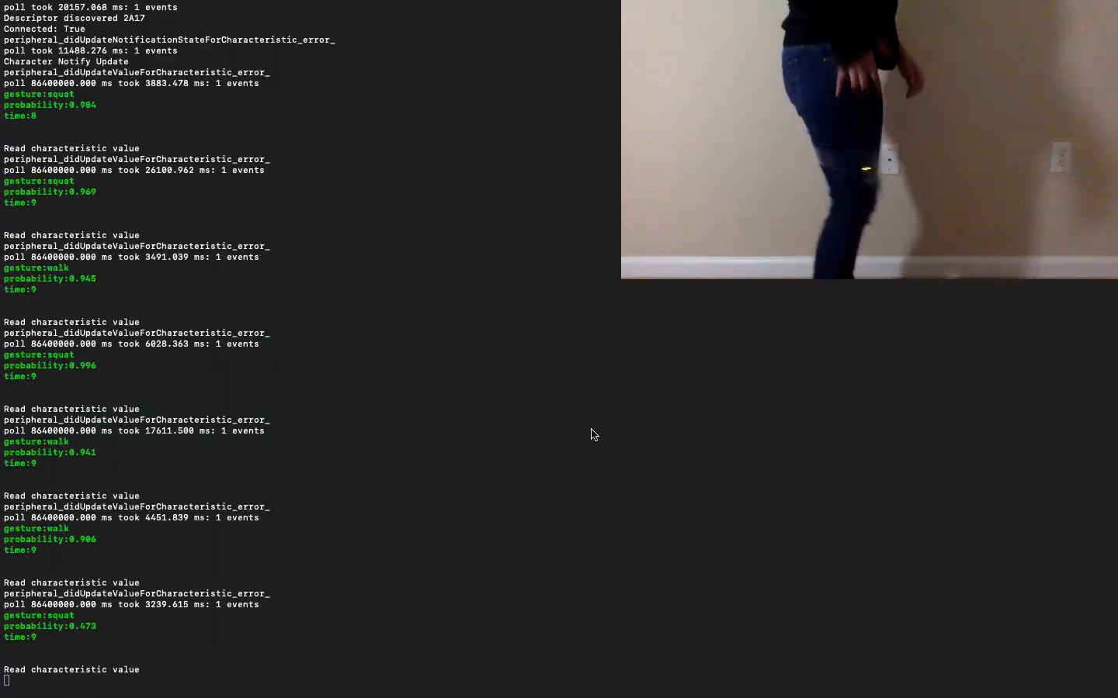
Predicting Jump gesture

Slide 38
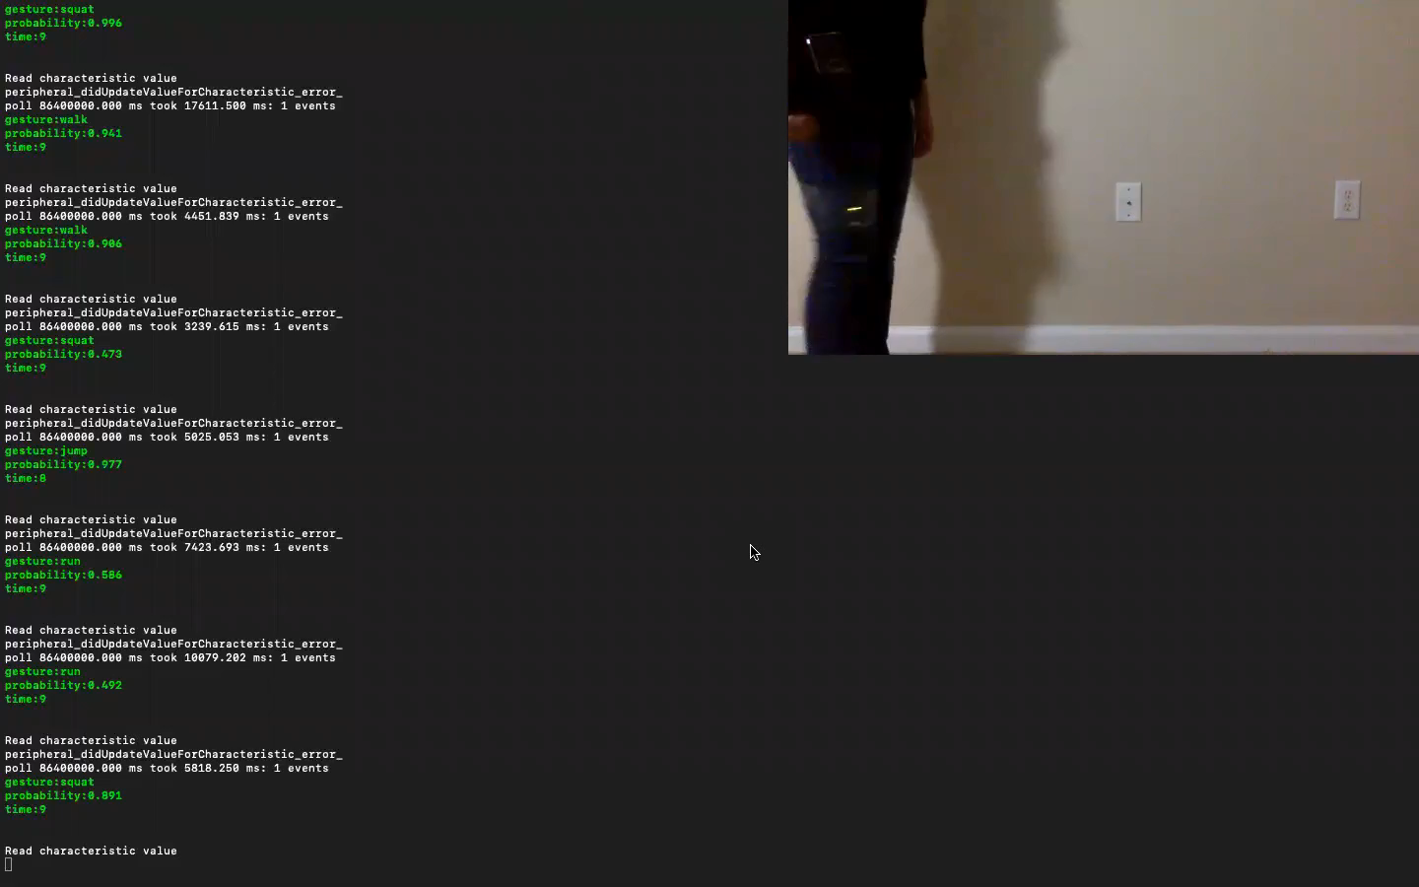
Predicting Walk gesture

Slide 39
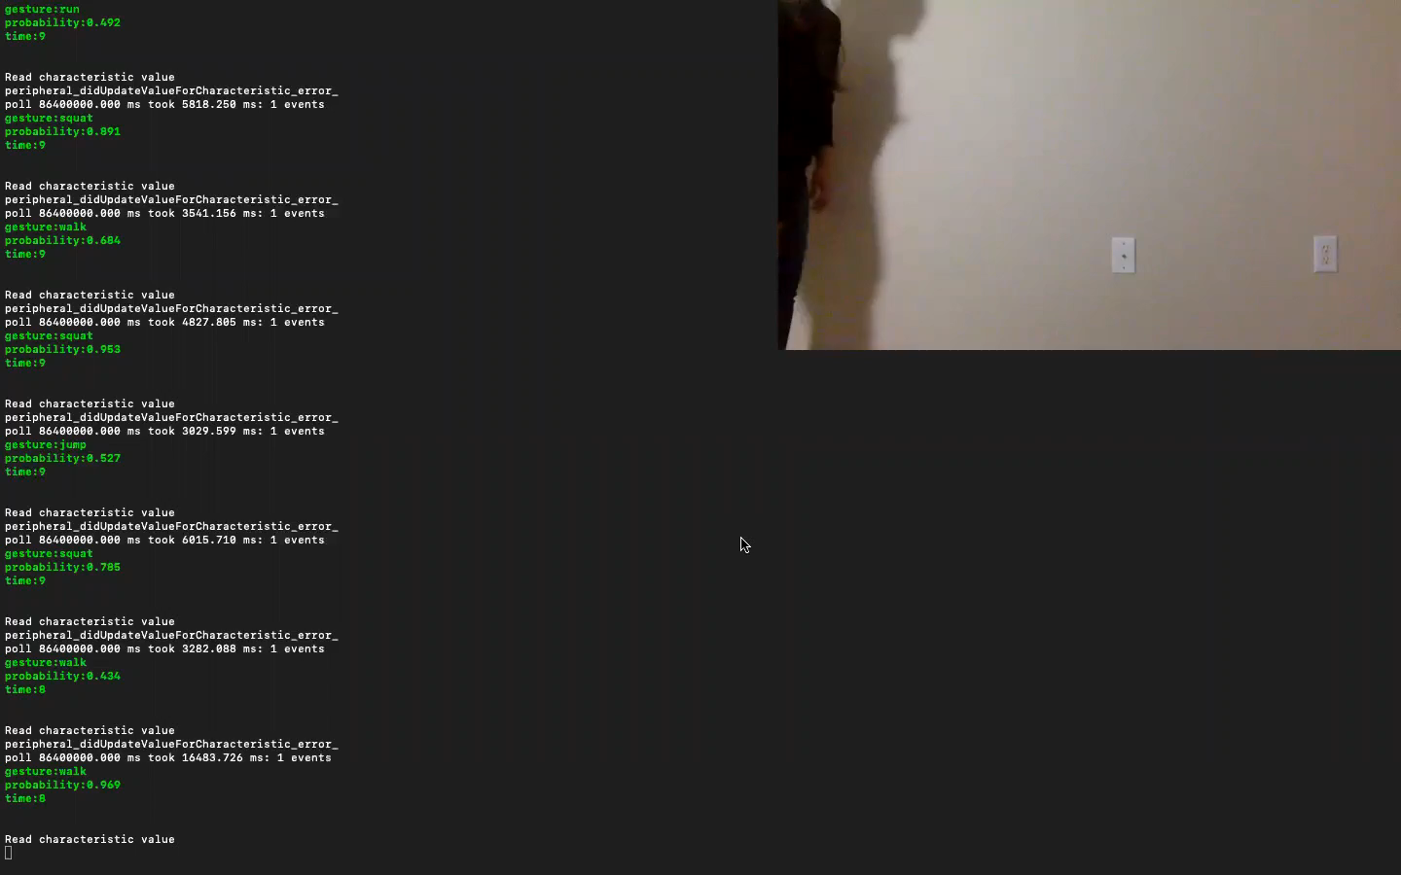
Predicting Run gesture

Slide 40
Conclusion
This research work shows us how simple and efficient it is to achieve an end to end application involving deep learning to predict human gesture with real data.
Gestures application showcases all the benefits the microcontroller offers as mentioned in goals
Along with the benefits, the tiny form factor and embedded sensors can be used as a wearable device and therefore used in building multiple real-world applications

Slide 41
References
1. https://www.arduino.cc/en/Guide/NANO33BLESense
2. https://blog.arduino.cc/2019/10/15/get-started-with-machine-learning-on-arduino
3. https://bleak.readthedocs.io/en/latest/
4. https://github.com/hbldh/bleak
5. https://keras.io/api/
6. https://www.tensorflow.org/model_optimization/guide/pruning/pruning_with_keras
7. https://www.tensorflow.org/model_optimization/guide/quantization/post_training

Slide 42
Git URL
https://github.com/UNCG-DAISY/Tiny_Gesture

Slide 43
QUESTIONS ?

Slide 44
THANK YOU

